Slide 1
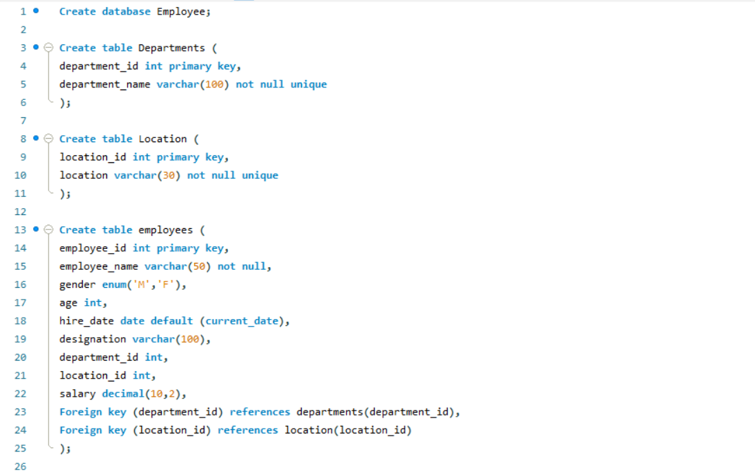
DDL COMMANDS AND CONSTRAINTS

Slide 2
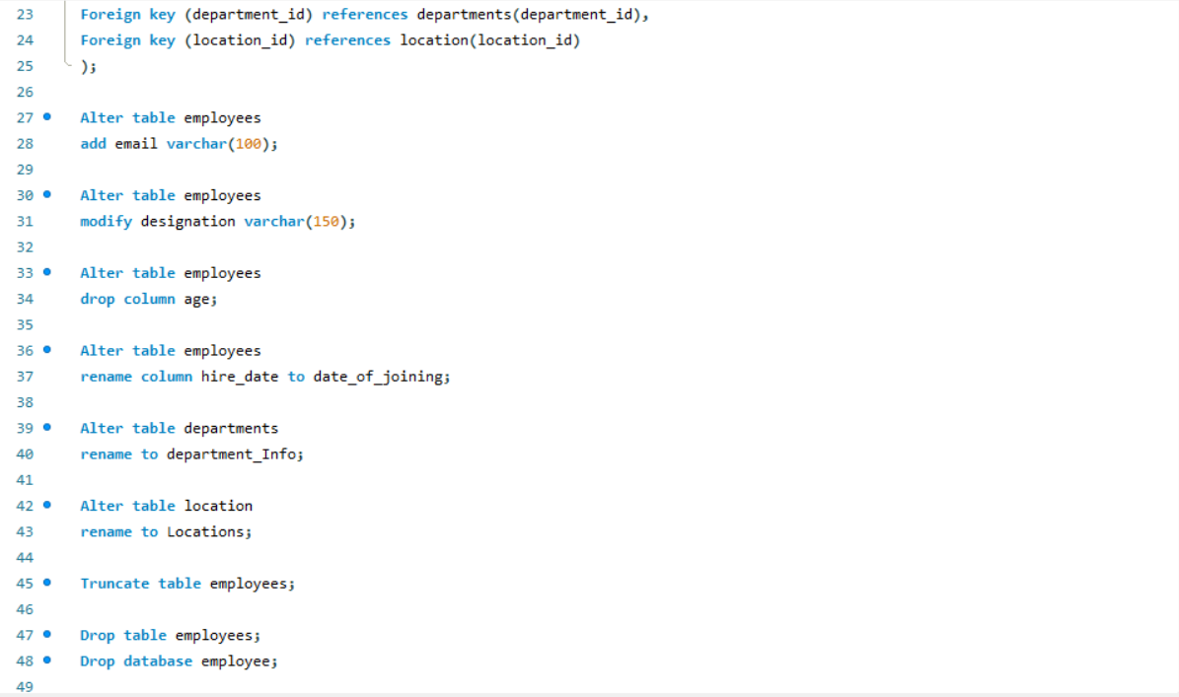

Slide 3
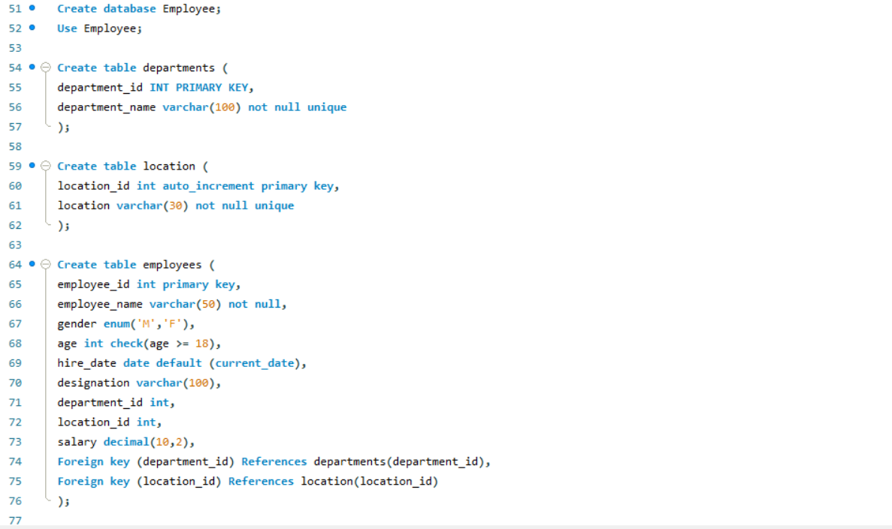

Slide 4




